Slide 1
STAT115 Lab 3
February 11 / 13
RNA-seq, Batch effects, differential gene expression analyses

Slide 2
Unit 2 – opportunities for help
Labs:
Feb 11, 18 from 5:30pm – 7pm @ HSPH LL6 (Longwood)
Feb 13, 20 from 6-8:15pm @ Science Center 309 (Cambridge)
Office hours (w/ Caleb):
Thurs, Feb 13 from 1:30pm-3pm. Bauer Laboratory Café/Lobby (Cambridge)
Tues, Feb 18 from 2pm-3:30pm. TMEC common area (Longwood)
Thurs, Feb 20 from 1:30pm-3pm. Bauer Laboratory Café/Lobby (Cambridge)
Sat, Feb 22 from 12:00pm – 2pm. Science Center commons-- 1st floor (Cambridge)
Please post on Canvas discussion for help when working remotely!

Slide 3
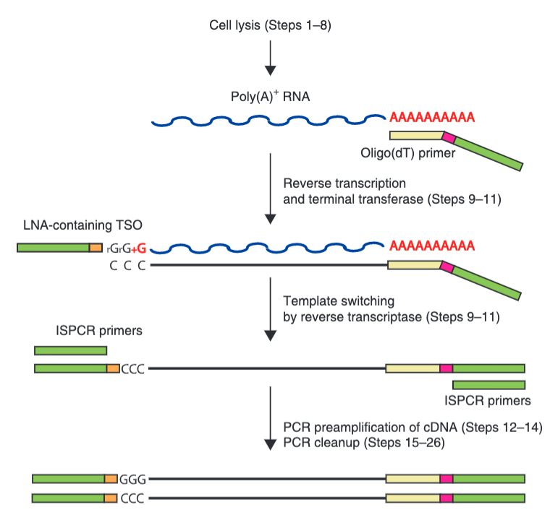
Reminder: RNA-seq isn’t typically sequencing RNA
Picelli et al. Nature Protocols 2013

Slide 4
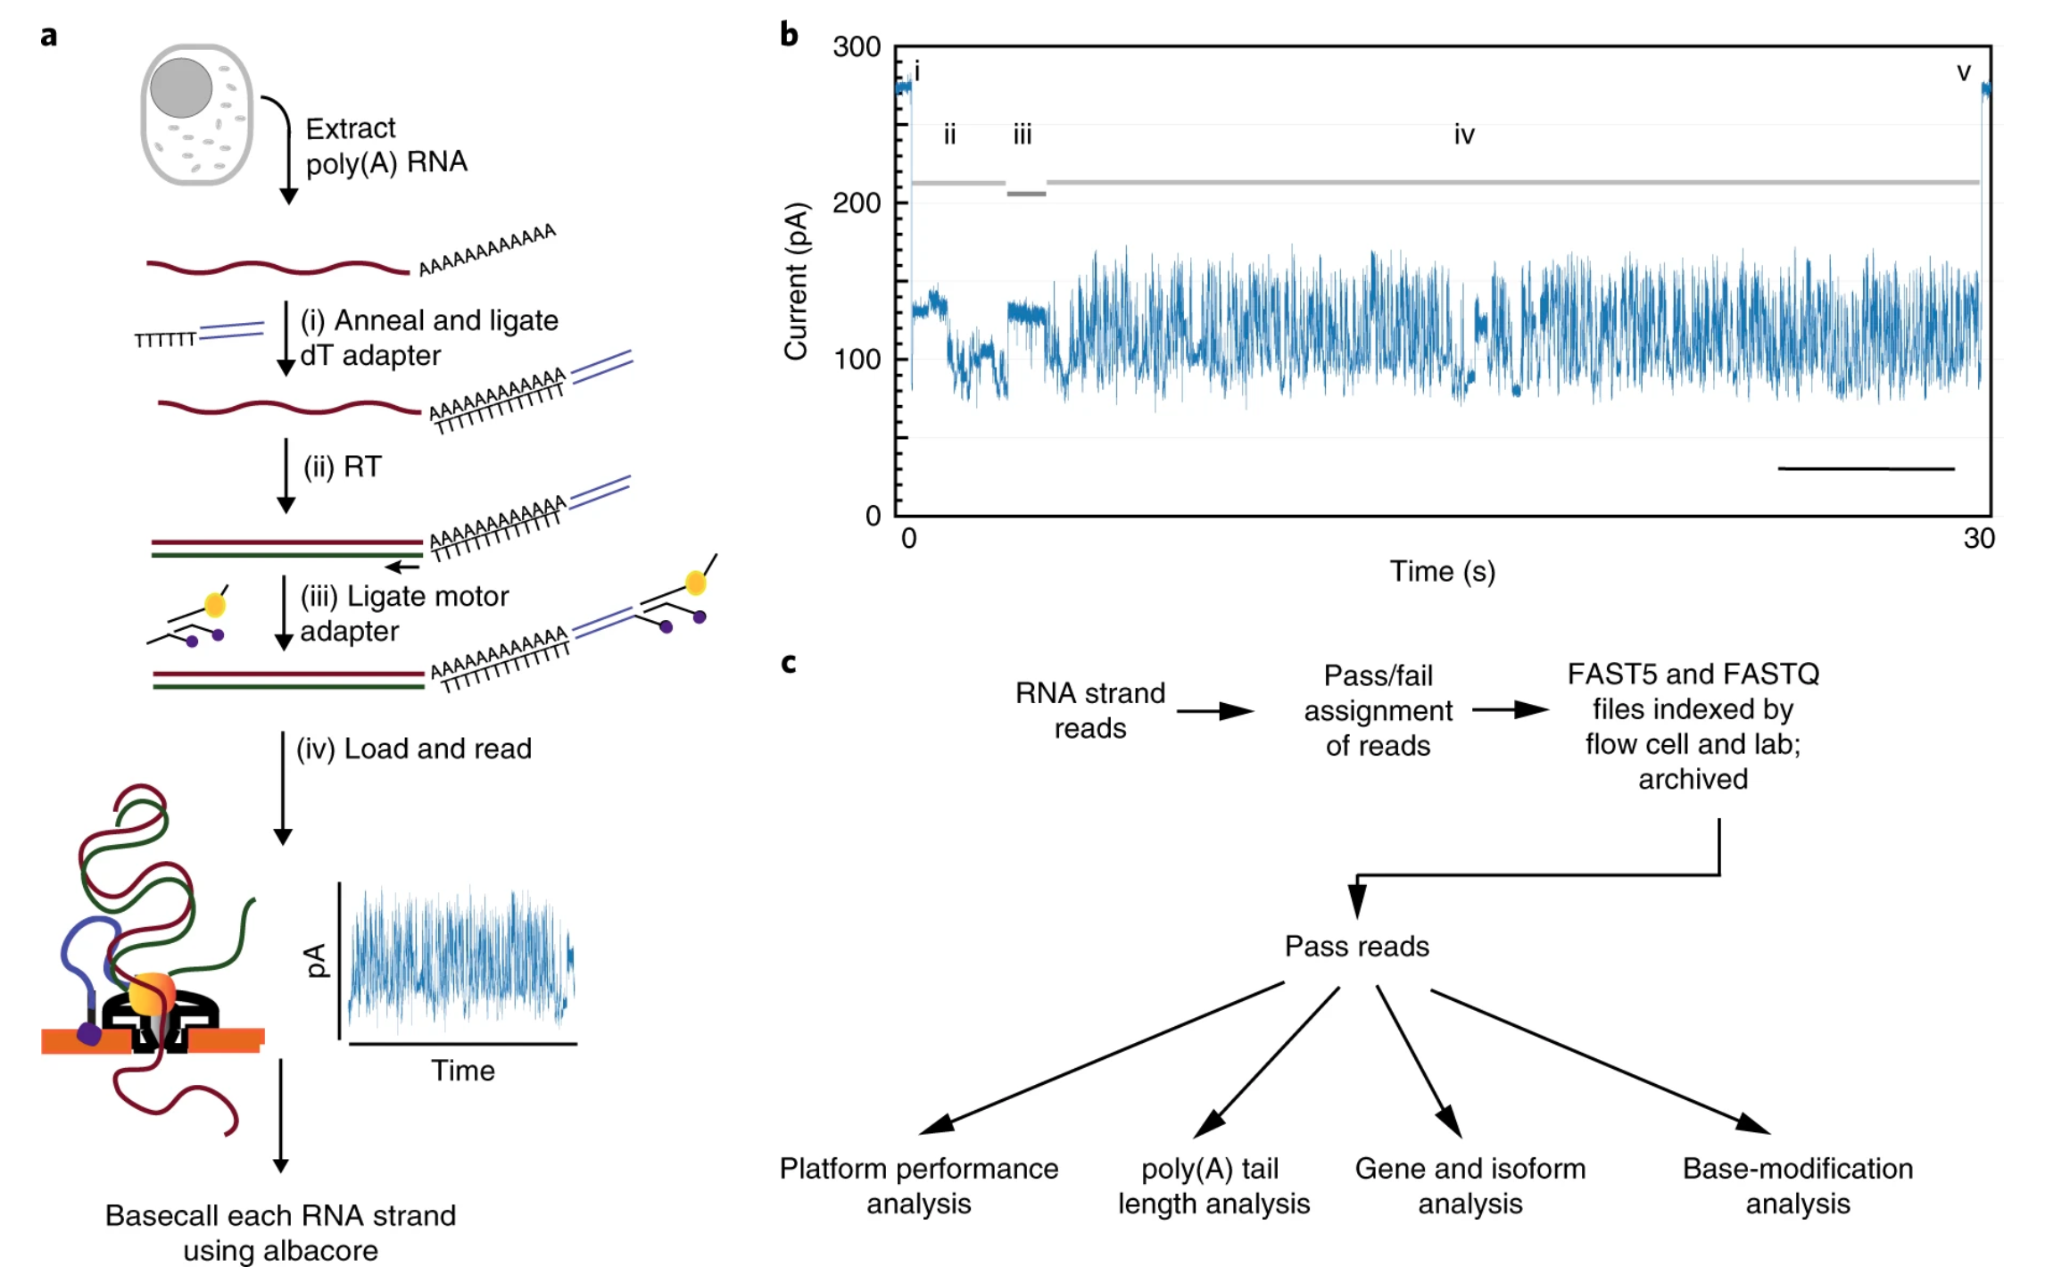
Now technically possible with the nanopore
Workman et al. Nature Methods 2019

Slide 5
Sequencing is not the only way to determine RNA abundances
From Otogenetics

Slide 6
Batch effects

Slide 7
What are they?
Providing a complete and unambiguous definition of the so-called batch effect is a challenging task, especially because its origins and the way it manifests in the data are not completely known or not recorded.
In molecular biology, a batch effect occurs when non-biological factors in an experiment cause changes in the data produced by the experiment. Such effects can lead to inaccurate conclusions when their causes are correlated with one or more outcomes of interest in an experiment.
Source: Wikipedia

Slide 8
Batch effects from various points of view
Biologist:
The experiments for group A were done on day 1 with reagents and machine X.
The experiments for group B were done on day 3 with reagents and machine Y.
We want to compare samples from groups A and B.
Statistician:
Suppose you want to observe the effect of X on Y but there exists a confounder Z. Z is associated with both X and Y.
Bioinformatician:
The data exists in a naïve state that, if uncorrected, will not allow be to understand the effect of the variable being measured (e.g. the drug treatment).

Slide 9
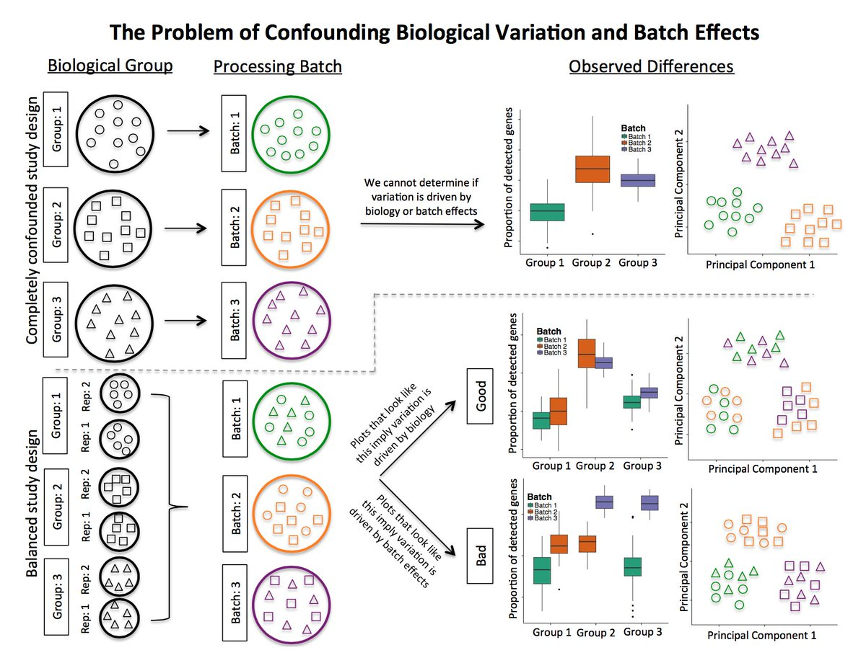
In a well-controlled experiment, batch effects are minimal
Hicks et al. 2017 Genome Biology

Slide 10
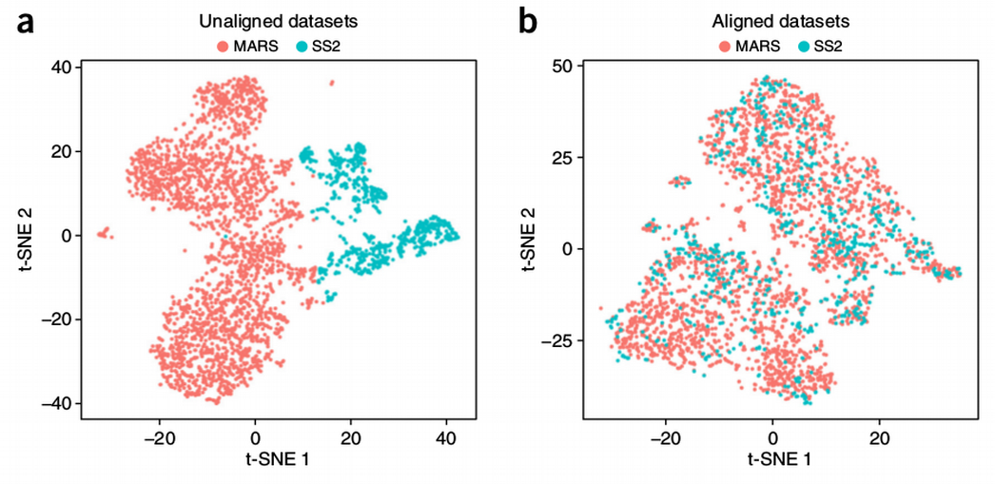
In single-cell data -> ‘alignment’
Butler et al. Nature Biotechnology 2018

Slide 11
Think about how batch effects in these contexts:
Scenario 1: only 3 or 4 genes are induced by a very specific perturbation (e.g. CRISPR activation of an enhancer). The control gRNA experiments are performed with a different cell culture.
Scenario 2: Peripheral blood from 100 patients with AML are drawn and processed. You later realize that you want to compare them to healthy individuals. You recruit 100 controls.
Scenario 3: You process blood from 4 AML patients with 4 controls. You repeat this every day for ~4 weeks until you get a sample size of 200.

Slide 12
Homework – 6 parts
HW DUE: Sunday, February 23 @11:59pm.
HW RETURNED: Thursday, February 27 (I hope)
Part 1: RNA-seq QC (3/3.5)
Part 2: Pseudoalignment (2/3)
Part 3: Differential gene expression/batch effects (5/6)
Part 4: Gene ontology (2/3)
Part 5: Python programming (2/2)
Part 6: Batch effects in the literature (1/2.5)
Red = need to use Odyssey
Blue = points per question for (STAT115/STAT215)

Slide 13
Part 1: RNA-seq QC + Odyssey work

Slide 14
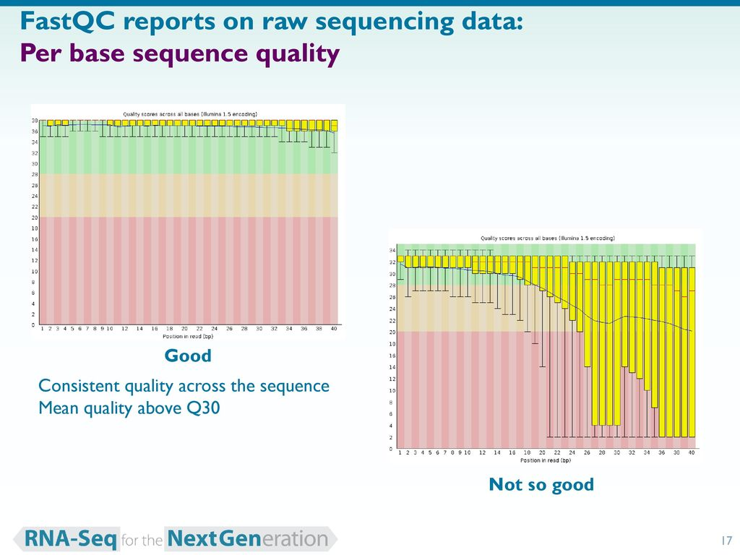
FastQC
Super fast + easy to use!
> fastqc <fastq_file>
From Bethany Hill

Slide 15
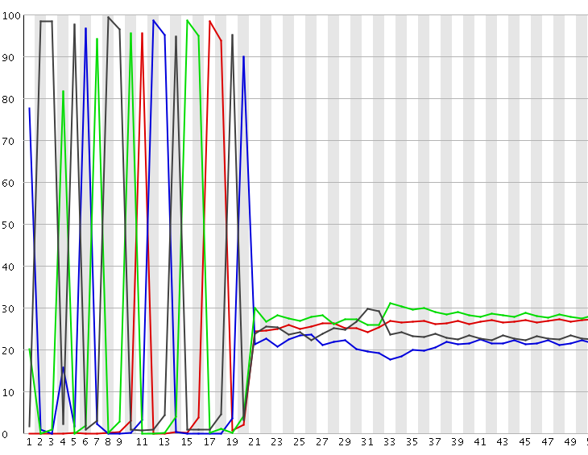
FastQC
% nucleotide frequency
Position in read

Slide 16
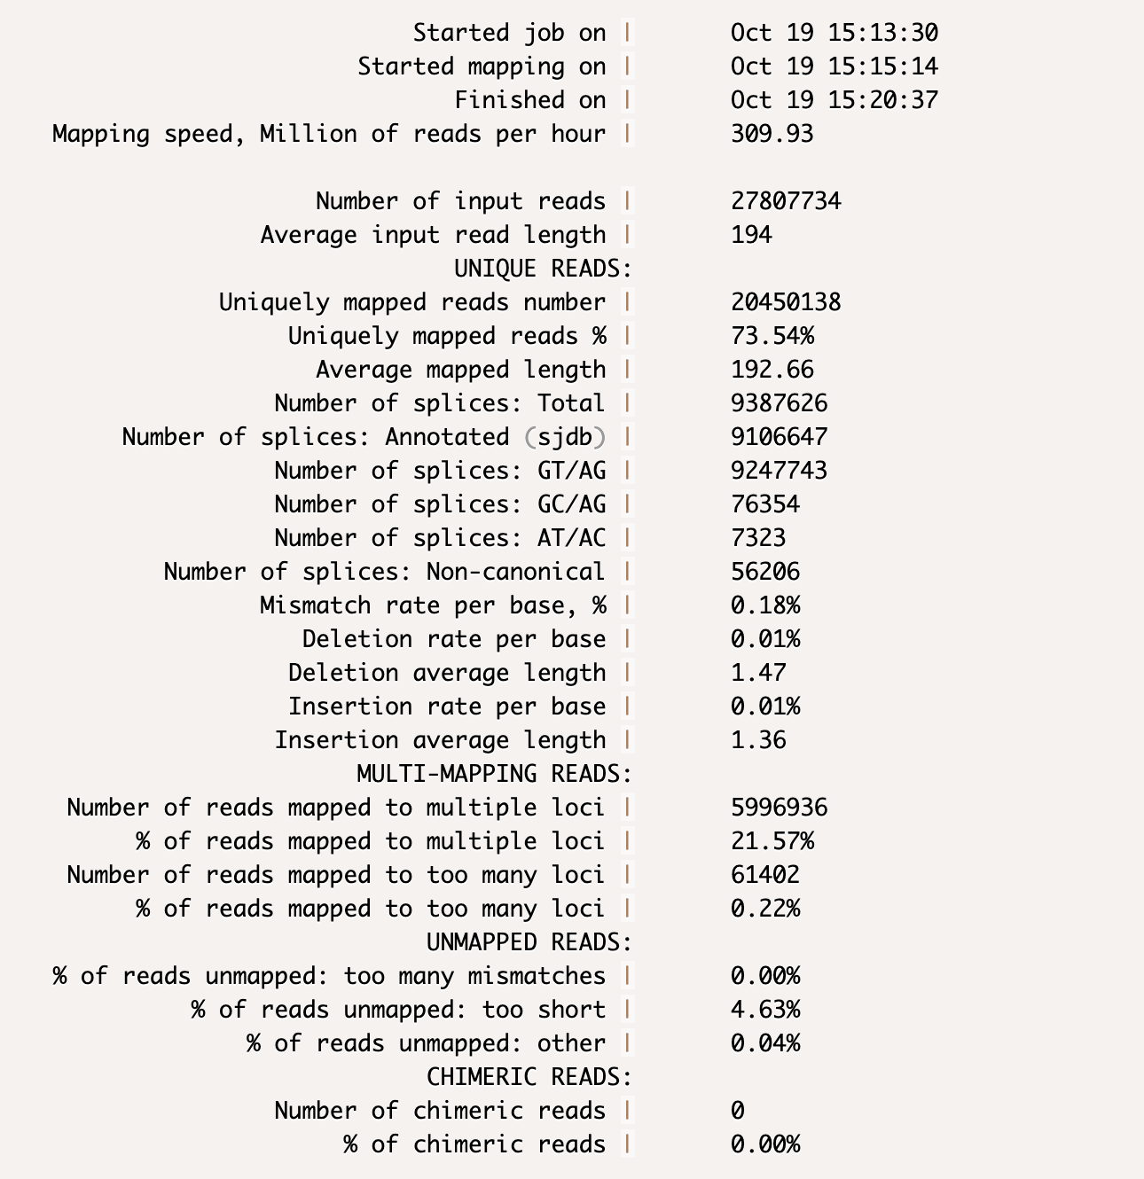
STAR QC (via alignment)

Slide 17
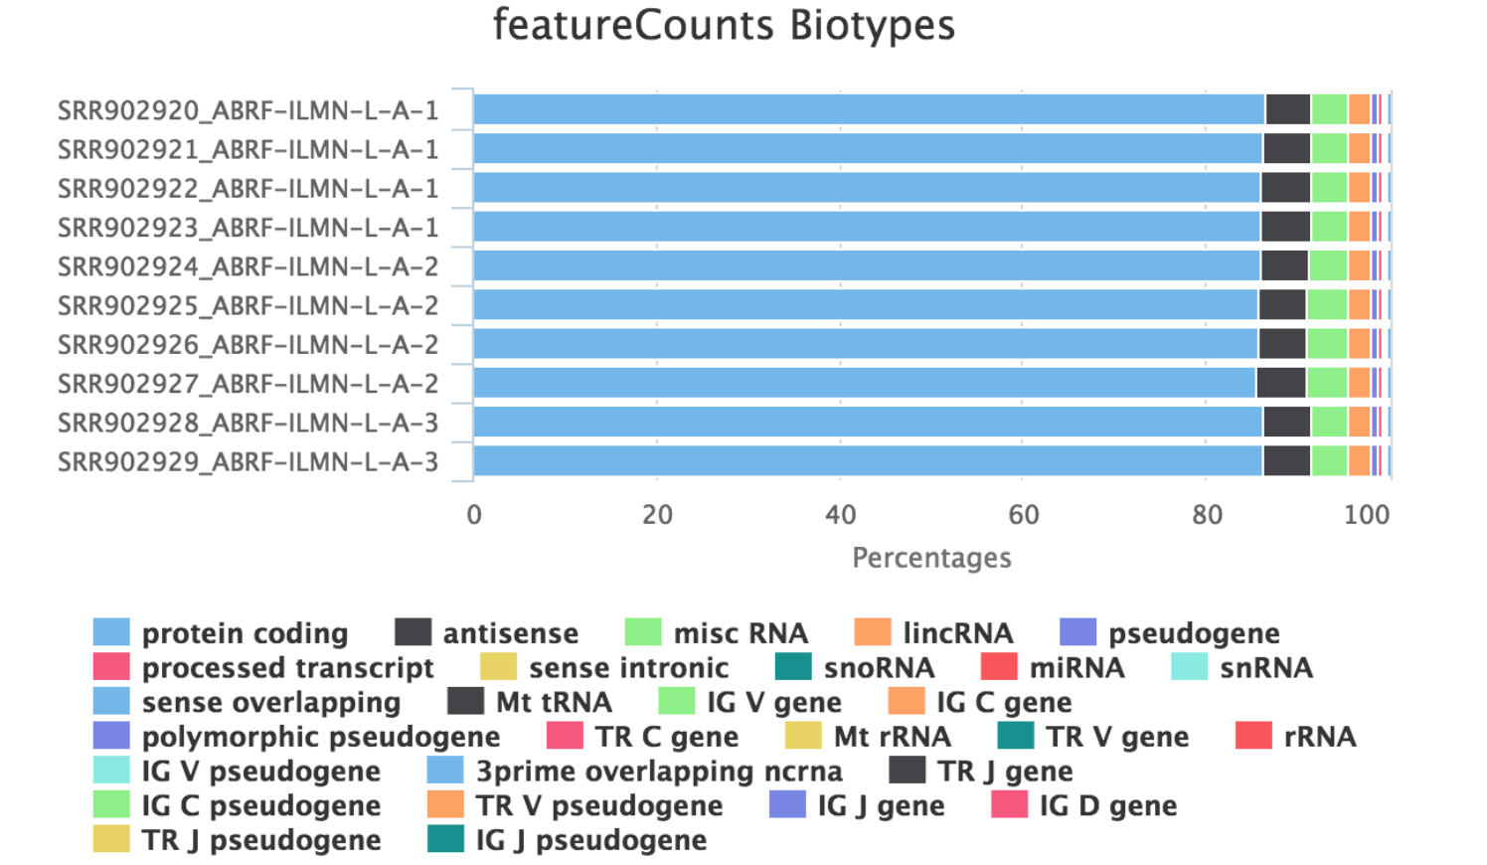
More RNA-seq QC
https://github.com/nf-core/rnaseq/blob/master/docs/output.md

Slide 18
Odyssey work – log on and execute the following
> module load Anaconda/5.0.1-fasrc02
> conda create -n <env_name> python=2.7
> source activate <env_name>
> conda install -c bioconda rseqc
Run line #2 only once to set up environment
Run line #3 to reuse the environment (e.g. you go home and log back on)
N.B. we are only using Python 2 because the recipe exists for rseqc

Slide 19
Python 3 conda environment (not required for this lab)
> module load Anaconda3/5.0.1-fasrc02
> conda create -n python3env python=3.8
Can toggle environments:
> source activate python3env
> source activate python2env

Slide 20
Execute tin.py from RSeQC for a quick test
> bed=/n/stat115/2020/HW2/lab3/small_hg38_RefSeq.bed
> cp /n/stat115/2020/HW2/lab3/test_* .
> bam=test_small_bam.bam
> python ~/.conda/envs/<env_name>/bin/tin.py -i $bam -r $bed
> head *summary.txt
NOTE: Do not use this bed for the homework! It is a subset of transcripts to use for faster processing. The real .bed file has ~150,000 lines. Takes ~2hr to run.

Slide 21
Part 2 - Pseudoalignment
Two main tools:
- Salmon (used in this problem set)
For HW: salmon quant -r
- Kallisto (generally the same)
Nice to use if restricted to a laptop
STAR is very fast too but requires a lot of RAM
Limitations…?

Slide 22
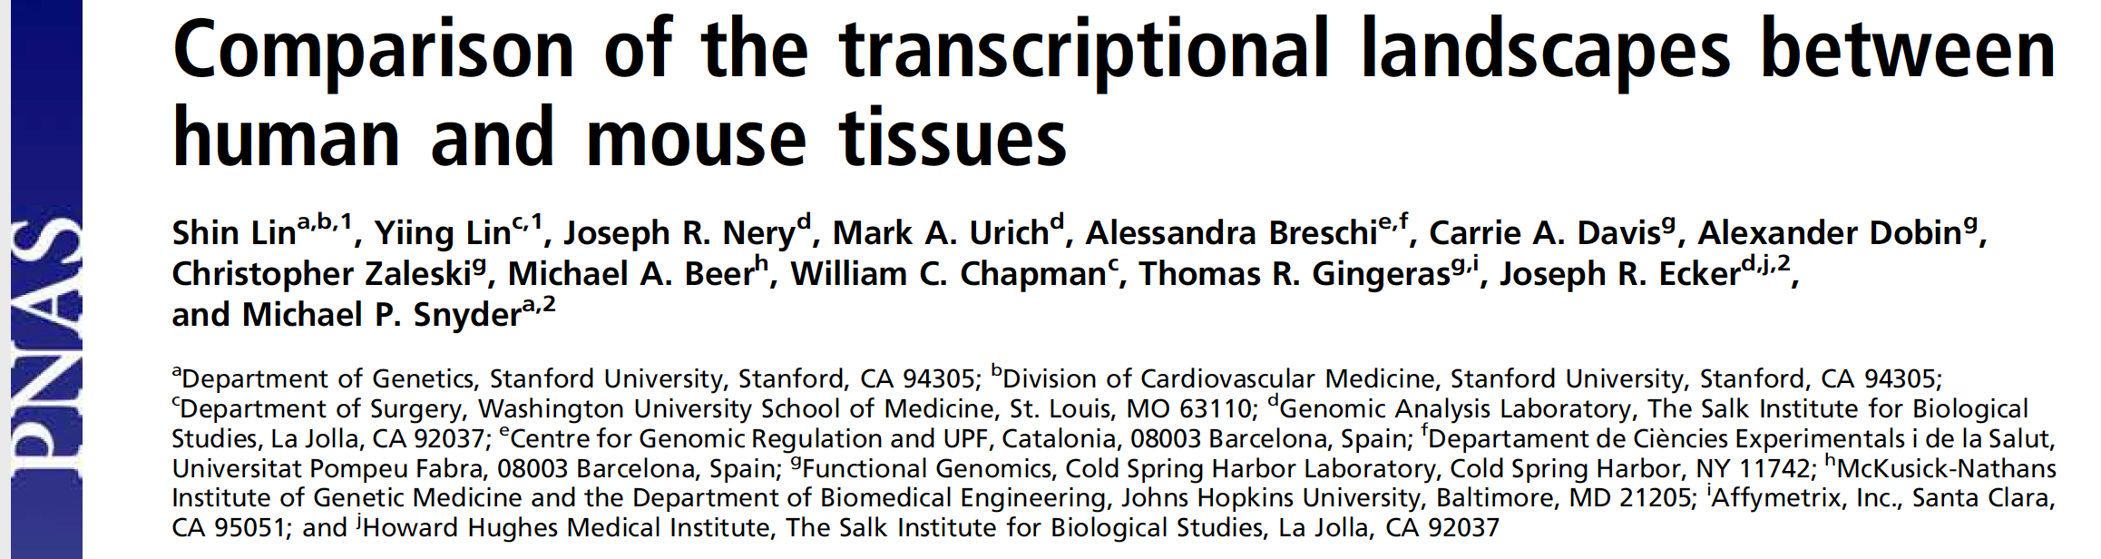
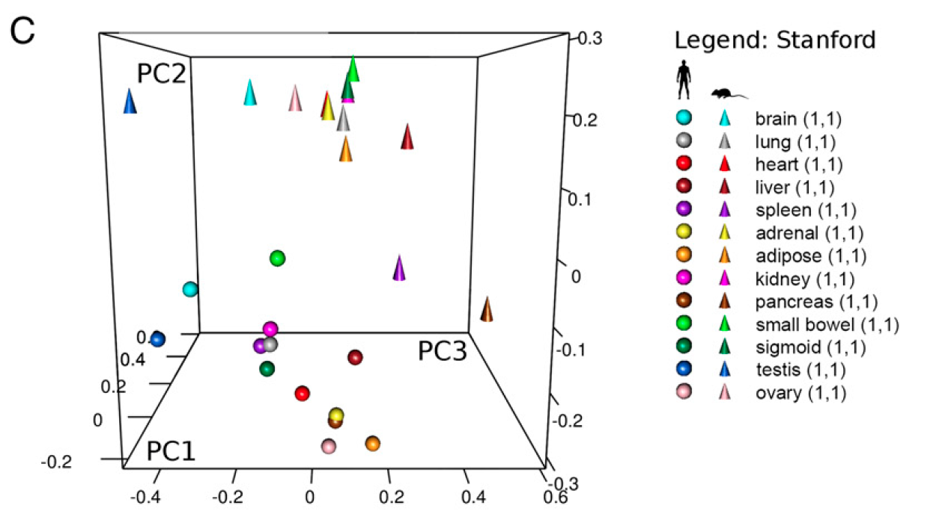
Part 3
Will walk through sample R code after break…

Slide 23
DAVID example (see part 4 in homework)
Use the “erythroid_genes.txt” list to check for gene set enrichment using the web-based tool.

Slide 24
Python programming (Part 5)
import matplotlib.pyplot as plt
Rough pseudocode:
Script imports a directory name
Identifies all files + their names
Pull coverage per position into a data vector / list
Plot value per position and add the original name

Slide 25
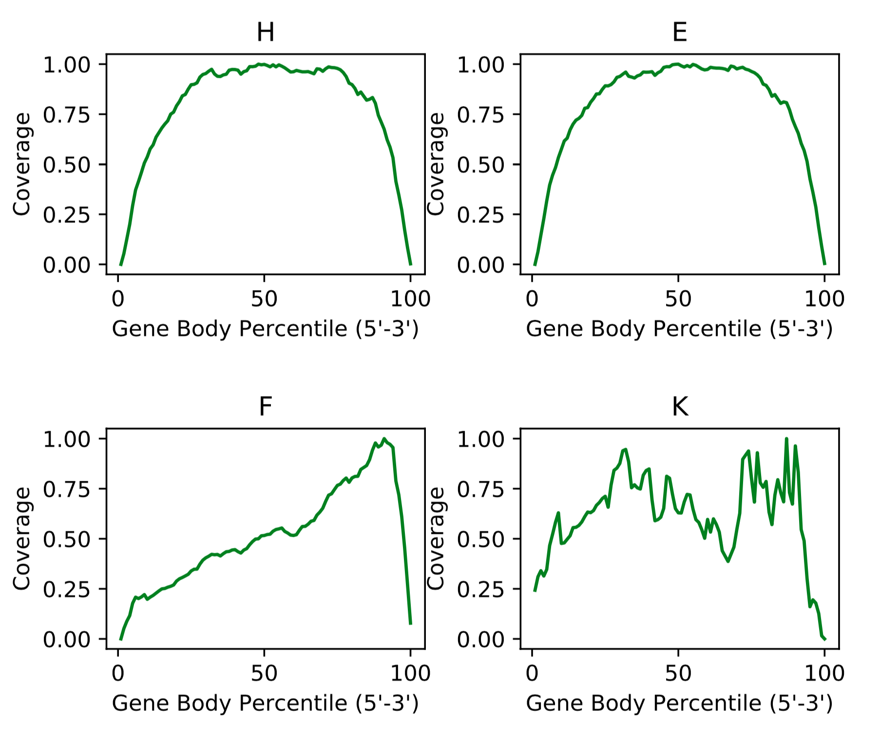
Example

Slide 26
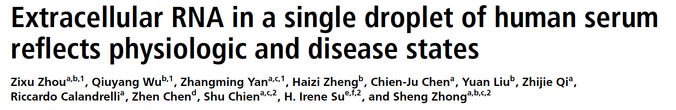
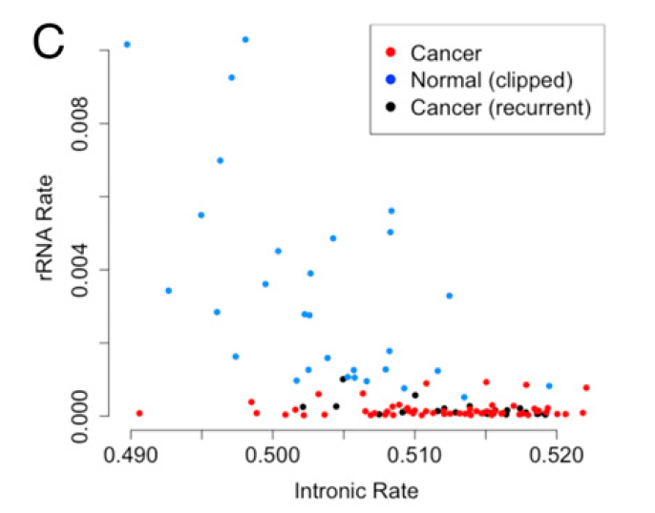
Part 6 – very recent batch example (2019/2020)

Slide 27
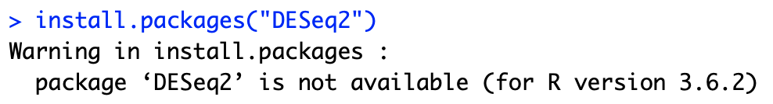
Common R error
1. Trying to install a Bioconductor package via CRAN
Fix:: use BiocManager::install
This error message is poorly communicated. When in doubt, google
‘install R package xyz’ (e.g. xyz = DESeq2) and you will see if it is on
CRAN or Bioconductor

